Slide 1
What is a Line?
A Brief Overview of: Topology

Slide 2
Topology is the Core of Math
All of the math you normally do uses topology (without you knowing it)
Math with real numbers
(like 3.5+2.2)
is a type of topology
Topology is hard to describe

Slide 3
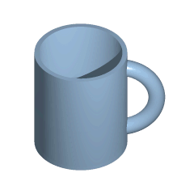
Some Definitions of Topology
Topology is the mathematical study of the properties that are preserved through deformations, twistings, and stretchings of objects. Tearing, however, is not allowed.
It is the modern version of geometry
The cup and the donut are topologically the same
http://upload.wikimedia.org/wikipedia/commons/2/26/Mug_and_Torus_morph.gif

Slide 4
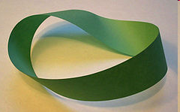
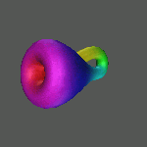
Topological Objects
A Möbius strip, an object with only one surface and one edge.
A Klein Bottle, a surface in four dimensions with only one side. It passes through itself in the fourth dimension.
Topologists study objects like these

Slide 5
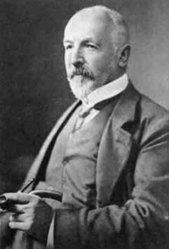
Georg Cantor
Developed the basis of set theory
Was the first person to formally describe infinity
His ideas were ridiculed and he was called a “scientific charlatan”, a “renegade”, and a “corruptor of youth”
Georg Cantor
1845-1918
http://commons.wikimedia.org/wiki/File:Georg_Cantor.jpg

Slide 6
How Many Integers are There?
Compare the set of positive integers with the set of even positive integers. Which set is larger?
Notice that every integer can be paired with an even integer
The two sets have the same cardinality
Even Positive Integers | All Positive Integers
2 | 1
4 | 2
6 | 3
8 | 4
10 | 5
12 | 6
14 | 7
16 | 8
. . . | . . .

Slide 7
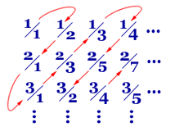
How Many Rational Numbers?
List the rational numbers in a pattern like this
The red line will eventually touch every rational number
If you number them 1, 2, 3, 4, … then you can see the rational numbers have the same cardinality as the integers
http://www.math.hmc.edu/funfacts/ffiles/30001.3-4.shtml

Slide 8
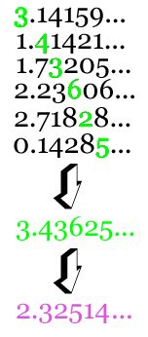
How Many Real Numbers?
If the real numbers have the same cardinality as the integers, you can list them all
Cantor discovered this diagonal slash. Subtract one from each green digit to get the purple number
The purple number isn’t on the list. The real numbers are more infinite than infinity!
http://www.math.hmc.edu/funfacts/ffiles/30001.4.shtml

Slide 9
Geometry and Set Theory
A line is a set of points that satisfy a linear equation in two dimensions
A plane is a set of points that satisfy a linear equation in three dimensions
Armed with this new set theory, Felix Klein (1849-1925) and others developed a new geometry that merged Euclidean and Cartesian forms
Klein wrote: “No one shall expel us from the Paradise that Cantor has created”

Slide 10
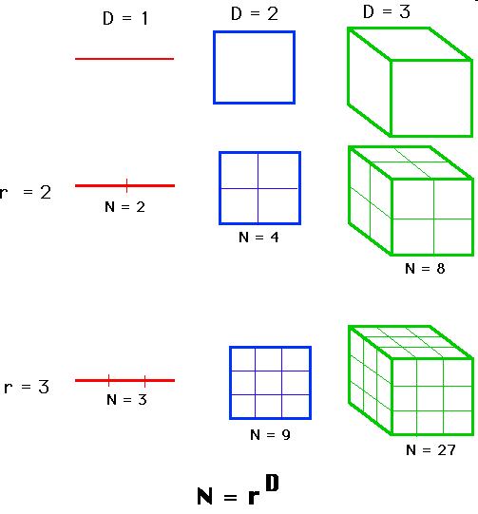
Dimension
We normally think of dimension as either 1D, 2D, or 3D

Slide 11
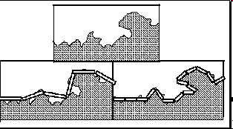
How Long is a Coastline?
The length of a coastline depends on how long your ruler is
The ruler on the left measures a 6 unit coastline
The ruler on the right, half the size, measures a 7.5 unit coastline

Slide 12
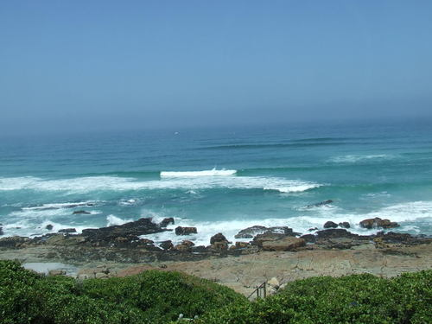
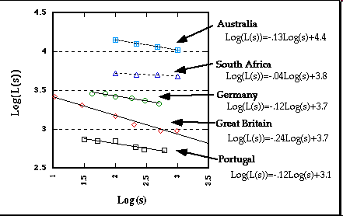
Fractal Dimension
For any specific coastline, s is the length of the rule and L(s) is the length measured by the ruler. A log/log plot gives a straight line
The steeper the line, the rougher the coast
The fractal dimension of a coast is (1 - slope )
The steeper the slope, the rougher the coastline
Photo downloaded 5/12/10 from http://cruises.about.com/od/capetown/ig/Cape-Point/Cape-of-Good-Hope.htm

Slide 13
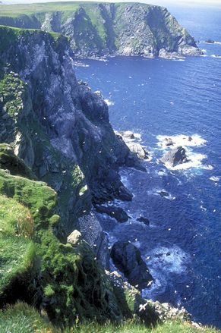
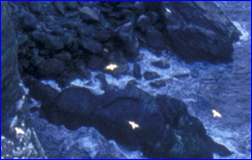
Repeating Scales
This is the Scottish coast
All fractals are “self similar” – they have similar details at big scales and little scales
Notice how the big bays are similar to the small bays, which are similar to the tiny inlets
http://visitbritainnordic.wordpress.com/2009/06/09/british-history/

Slide 14
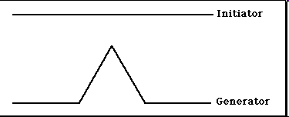

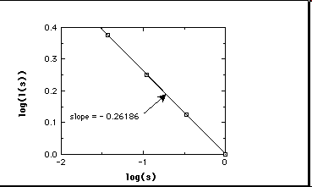


The Koch Curve
The Koch Curve has a fractal dimension of 1.26

Slide 15
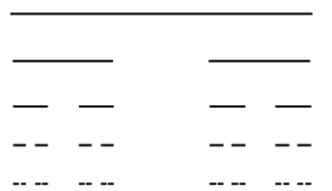
Cantor Dust
Cantor Dust is created by removing the middle third of every line
Cantor Dust has a fractal dimension of 0.63

Slide 16
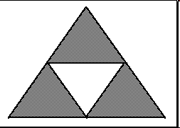
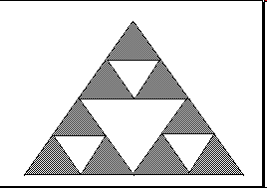
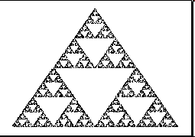
Sierpenski Carpet
The Sierpenski Triangle is created by removing the middle third of each triangle
The fractal dimension is 1.59

Slide 17
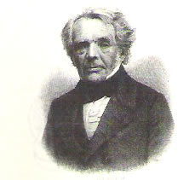
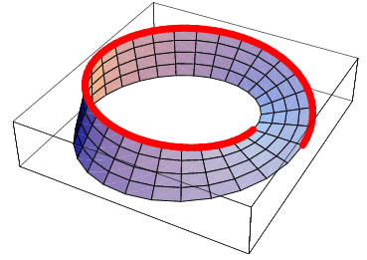
August Ferdinand Möbius
(1790-1868)
He discovered the Möbius strip when he was 68 years old
An active astronomer and mathematician
Was a loner who worked independently

Slide 18

The Möbius Strip
Möbius discovered this shape in 1858
It was almost unknown until his papers were gone through after he died
It is seen today in art and jewelry
The “recycling” symbol is a Möbius strip

Slide 19
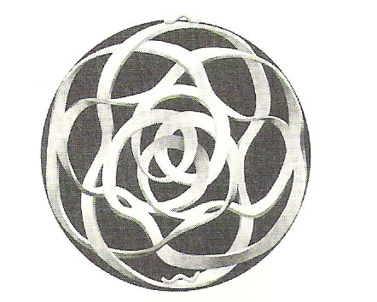
Möbius Art

Slide 20
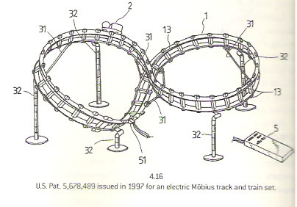
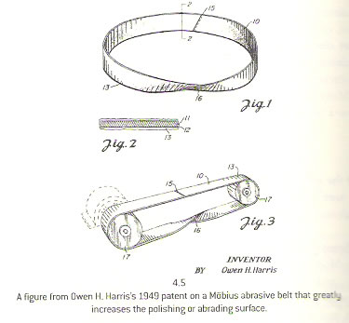
Möbius Inventions
The Möbius Strip, Clifford Pickover, Thunder’s Mouth Press, 2006

Slide 21
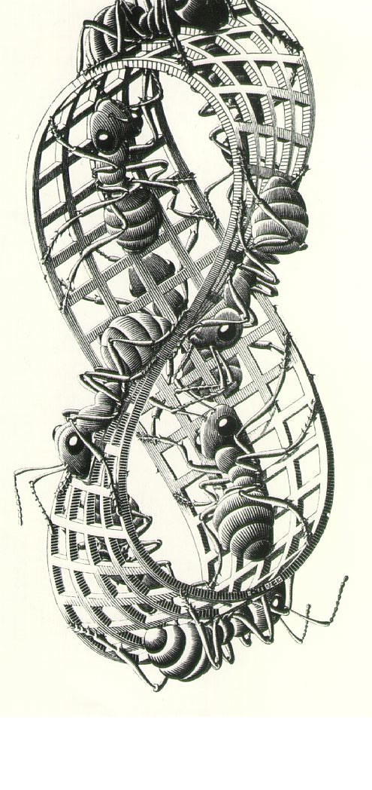
Möbius Ants
(M.C. Esher)
Said the ant to its friends: I declare!
This is a most vexing affair.
We’ve been ‘round and ‘round
But all that we’ve found
Is the other side just isn’t there!

Slide 22
Make a Möbius Strip
Using the provided paper, cut out two strips
Tape them together to form a ring but put in one half-twist before you finish it

